Slide 1
Global Sales Performance Dashboard
Subtitle: Power BI Dashboard Presentation Name :GUMMANA LOHITHA Date : 26-06-2025

Slide 2
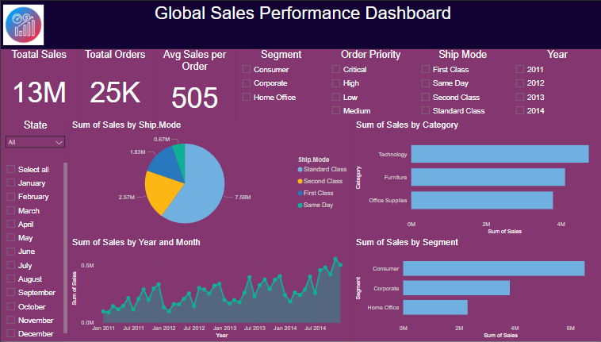

Slide 3
Project Overview
Dataset Used:
Global Superstore Sales Data (2011–2014)
Fields: Sales, Profit, Quantity, Product Info, Customer Info, Geography, Dates
Objective:
Analyze total sales performance
Identify trends and patterns across time, region, category, and segment
Tools Used:
Power BI (Data Modeling, DAX, Visualizations)

Slide 4
Key KPIs & Metrics
Total Sales - 13M
Total Orders - 25K
Average Sales Per Order – 505
Total Quantity -178K

Slide 5
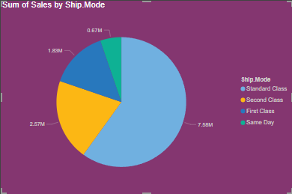
🔍 Insight Summary:
Standard Class is the dominant shipping method, generating ₹7.56M in sales — over 50% of total.
Second Class follows with ₹2.57M in sales.
First Class contributes ₹1.83M, indicating use in high-value or urgent deliveries.
Same Day shipping, while the fastest, accounts for the least sales at ₹0.67M — possibly due to limited availability or higher cost.
📈 Key Takeaways:
Standard shipping is the most preferred and cost-effective method.
Opportunity to promote Same Day or First Class for premium customers.
Analyze shipping performance vs. delivery time and customer satisfaction for strategic improvements.

Slide 6
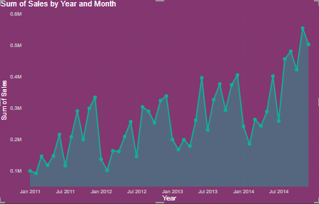
📊 Chart analysis:
The Line and Area chart shows a steady upward trend in monthly sales from Jan 2011 to Dec 2014.
There is a seasonal pattern, with sales peaks recurring consistently around mid-year and end-of-year
Monthly sales grew from below ₹0.1m in early 2011 to over ₹0.6m in 2014, indicating strong business growth over four years.
🚀 Key insights:
Consistent year-over-year growth shows successful sales strategies and market expansion.
Potential to forecast future sales using this historical trend.

Slide 7
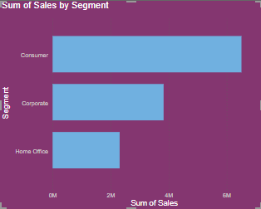
📊 Chart overview:
The horizontal bar chart displays total sales by customer segment.
Consumer segment leads significantly with over ₹6m in total sales.
The corporate segment follows, contributing around ₹3.5m.
Home office accounts for the least sales, slightly under ₹2m.
🔍 Key insights:
Consumer segment contributes to more than 50% of total sales, indicating strong demand and wider customer base.
Corporate customers are the second-largest group, possibly making bulk or high-value purchases.
Home office shows potential but underperforms, suggesting room for targeted engagement.

Slide 8
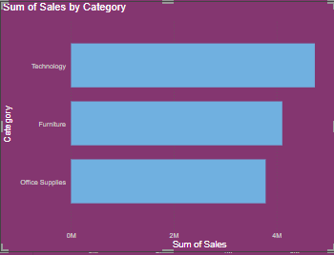
📊 Chart overview:
The bar chart shows total sales by three major product categories:
Technology
Furniture
Office supplies
Technology tops the list with sales exceeding ₹4M.
Furniture follows closely behind.
Office supplies is in third, but still shows strong performance.
🔍 Key insights:
Technology is the leading revenue generator, possibly due to higher unit prices and demand.
Furniture also performs well — likely from bulk office purchases.
Office supplies, while lower in total, may represent high volume at lower prices.

Slide 9
Key Takeaways
Findings:
Technology drives highest revenue
Standard Class dominates shipping preference
Consumer segment is the most valuable
Recommendations:
Focus on promotions in Technology & Consumer segments
Explore optimizing shipping methods for better cost control
Continue tracking growth trends post-2014 (future data extension)

Slide 10
Thank You

